Slide 1
Violent Weather
Tropical Cyclones

Slide 2
Tropical Storms & Hurricanes Outline
Definitions
Tropical Cyclone Classification
Characteristics
Formation
Hurricane Structure
Classification
Damage

Slide 3
Definitions
Unlike their Mid-Latitude cousins, Tropical Cyclones are Thermal, rather than Dynamic, Low pressure systems.
i.e. The Low Pressure is initiated by the warm temperatures of the tropical latitudes.
Depending upon their location and strength, Tropical Cyclones are given various classifications…

Slide 4
Tropical Cyclone Classification
Tropical Depressions
An organized system of clouds & thunderstorms with a defined circulation, and maximum sustained winds of 38 mph (61 km/h) or less.
At least one closed isobar
Tropical Storm
Winds of at least 39 mph (63 km/h)
The storm is named

Slide 5
Tropical Cyclone Classification
If maximum sustained winds reach 74 mph (119 km/h), the cyclone is called a:
Hurricane
In the North Atlantic Ocean, the Northeast Pacific Ocean east of the dateline, and the South Pacific Ocean east of 160°E
Typhoon
In the Northwest Pacific Ocean west of the dateline
(Super Typhoon if the maximum sustained winds are at least 150 mph / 241 km/h)
Cyclone
Indian Ocean, Southwest Pacific Ocean

Slide 6
Characteristics
Self-propagating
Driven by an internal ‘engine’
(Hurricane) Winds range from 74 – 155mph+
Generally less than that of Tornadoes
Diameter typically 350 miles (600 km)
Thousands of times wider than Tornadoes
Millions of times greater area than Tornadoes
Long Life spans
Tropical Cyclones may persist for a week or more
Tornadoes will last a couple of hours at most

Slide 7
Characteristics
Sea level pressure near center typically 950mb
Can be as low as 870mb!
Generates a very steep PGF that leads to extremely fast winds
In the Northern Hemisphere, Tropical Cyclones Form most frequently in August – September
When ocean temperatures and evaporation rates are highest
Actual NH season is June 1 – November 30

Slide 8
Formation
All Tropical Cyclones begin as Tropical Disturbances
Disorganized groups of Thunderstorms with little or no rotation
These Disturbances are caused by various means, but the most common cause are…
Easterly Waves
These are large ripples in the normal trade wind patterns
These cause convergence upon the eastern side of the ridge which leads to uplift.

Slide 9
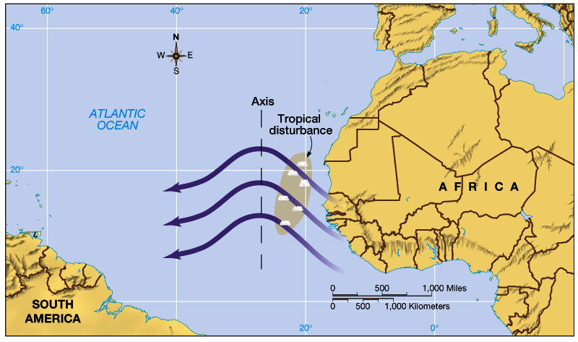
Fig. 12-9 p. 360

Slide 10
Formation
Most Tropical Disturbances dissipate prior to ever becoming organized Low’s
However, a small fraction will become Tropical Depressions
Of these Depressions, a smaller fraction will become a Tropical Storm
And of these, an even smaller fraction will become Hurricanes

Slide 11
Pre-Requisites for Formation
Vast quantities of fuel are required to power the internal ‘engine’ of a Tropical Cyclone
This fuel takes the form of warm ocean waters
Specifically, water of at least 27 °C (80 °F) at a depth of several meters
Such temperatures are found below about 20° latitude N & S

Slide 12
Pre-Requisites for Formation
The Coriolis Force is also a pre-requisite for the formation of Tropical Cyclones
This provides the rotation required to maintain the surface low
Thus, formation will not occur between 0 & 5° N & S

Slide 13
Pre-Requisites for Formation
Convectional Uplift
Atmospheric conditions must be sufficiently unstable to permit buoyancy
Along the eastern fringes of oceans, cold currents inhibit such conditions.
Thus most uplift occurs in the western basins of oceans
Weak Upper Level Winds
No wind shear!

Slide 14
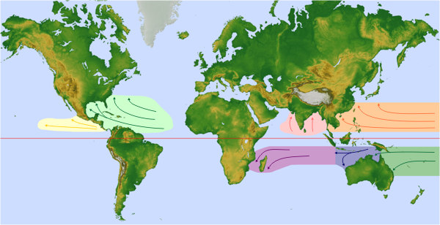
Tropical Cyclone Formation Basins
Typhoons
Hurricanes
Cyclones

Slide 15
Hurricane Structure
We’ve established that convectional uplift causes the Thermal Low Pressure of Tropical Cyclones.
This, of course, draws surface air toward the center of the storm (the eye) in a cyclonic pattern (counter-clockwise in the NH)
However, the pattern of this flow is NOT that of a UNIFORM convective cell.
Instead, Tropical Cyclones are comprised of a series of Thunderstorms that spiral about the eye!

Slide 16
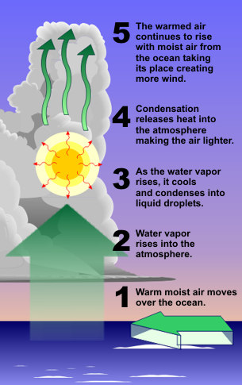
Hurricane Structure
Convectional Uplift only ‘kick-starts’ the process, however.
The Warm Ocean surface, through evaporation, provides vast quantities of latent heat to the Tropical Cyclone.
Hence, they are known as ‘Warm Core’ cyclones

Slide 17
Hurricane Structure
However, it is the condensation of these evaporated waters that ‘drives’ (self-propagates) the Tropical Cyclone
Condensation releases vast amounts of latent heat into the storm
This permits further, rapid lifting!

Slide 18
Hurricane Heat Engine (www.nasa.gov)

Slide 19
Hurricane Structure
This Lifting will continue until it reaches the Tropopause
Due to the ‘warm core’, pressure within the eye decreases at a lesser rate (less dense) with increased elevation than that of surrounding air.
Thus, we have an upper level ‘High’
This causes air to spiral out of the storm in an Anti-Cyclonic flow.
The lower temperatures at these altitude cause water droplets to freeze into Ice Crystals.
This generates the overlying blanket of Cirrostratus clouds

Slide 20
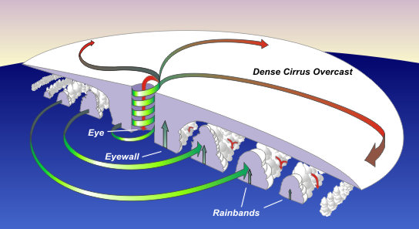

Slide 21
Hurricane Frances TRMM Imagery
NASA's Tropical Rainfall Measuring Mission satellite is able to cut through the overlying clouds that usually obscure the spiraling rain bands

Slide 22
Hurricane Structure
The Eye
Clear skies, slowly descending air, light winds
Range from 15 – 30 mi (20 – 50 km)
Avg. 20 mi (30 km)
Generally speaking, the smaller the eye the more intense the storm!
The Eye Wall
Bounding the eye is the eye wall.
This is the most intense region of the storm
Strongest winds, thickest cloud cover, greatest amounts of precipitation

Slide 23
Hurricane Structure
Double/Concentric Eye Walls
Sometimes Tropical Cyclones can form multiple eye walls
When this occurs, the inner eye wall will disintegrate, weakening the storm

Slide 24
Hurricane Structure
Hot Towers
Modern Remote Sensing technology has recently uncovered the presence of ‘Hot Towers’ within the eye wall of Tropical Cyclones.
Localized portions of the eye wall that rise to greater heights than the rest of the eye wall
This will usually indicate an impending intensification of the storm.

Slide 25
Hurricane Wilma TRMM Imagery (www.nasa.gov)

Slide 26
Hurricane Structure
Depletion of a Tropical Cyclone
A Tropical Cyclone will weaken once its fuel supply is cut-off!
i.e. It is robbed of warm water
This will occur once:
It moves over land (rapid weakening)
It migrates to colder waters
It remains stationary for too long
Cyclones remove the warm surface water.
This is replaced by colder water below (upwelling)

Slide 27
Cold Water Upwelling (www.nasa.gov)

Slide 28
Hurricane Fabian/Isabel Sea Surface Temp. (www.nasa.gov)

Slide 29
Hurricane Structure
Tropical Cyclones play a critical role in regulating temperature difference between equator and poles!
Recall that:
The Equator is cooler due to circulation
The Poles are warmer due to circulation
They form an important piece of Global Circulation

Slide 30
Classification
Hurricanes are classified according the Saffir-Simpson Scale which is based upon wind speed:

Slide 31
Damage
Tropical Cyclones are extremely violent events. Damage may be caused by:
Strong winds
Tornadoes
right forward quad, short-lived
Heavy Rains
Flooding
Storm surge
Lightning

Slide 32
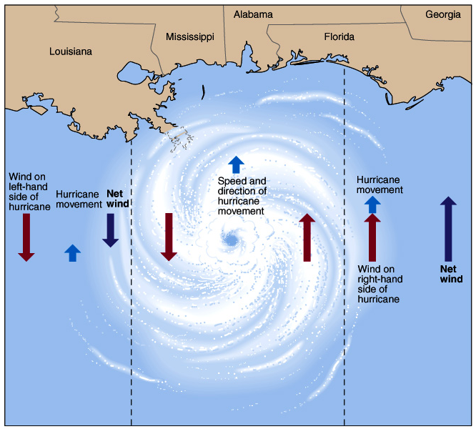
Fig. 12-17 p. 374

Slide 33
Common Tornado Spawning Locations
The ‘X’ marks the mean spawning location
Fig. 12-14 p. 372

Slide 34
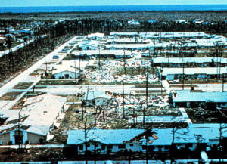
The occurrence of Tornadoes within Tropical Cyclones explain the seemingly ‘random’ total destruction of some homes in a neighborhood while others escape unscathed

Slide 35
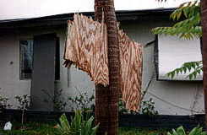
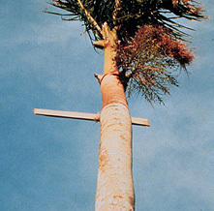
Tropical Cyclones are measured by their SUSTAINED winds.
However, wind gusts can exceed 250 mph!
Flying Debris are a major cause of destruction

Slide 36
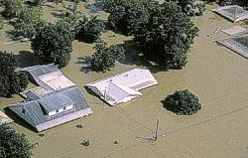
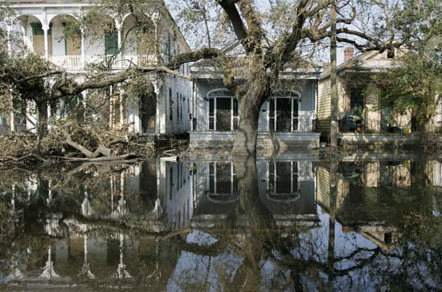
Flooding is BY FAR the most lethal effect of Tropical Cyclones!
Tropical Storm Allison (2001) dumped 3 FEET of rain over SE Texas over a 5-day period!
Hurricane Katrina leaves 1,300 dead in its wake after the levees of New Orleans were toppled by the rising waters of Lake Pontchartrain.

Slide 37
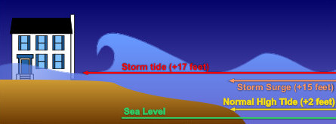
Damage
Storm Surge is of particular concern.
Simply water that is pushed toward the shore by the force of the winds swirling around the storm.
Advancing surge combines with the normal tides to create the hurricane storm tide
Can increase the average water level 15 feet (4.5 m) or more.
Wind driven waves are superimposed on the storm tide.

Slide 38
Damage
This rise in water level can cause severe flooding in coastal areas
Particularly when the storm tide coincides with the normal high tides.
AP Animation That Depicts VERY well the varying damage Cat 1-5 Storms:
http://www.npr.org/news/specials/hurricane/ap/
NASA Animation That nicely surmises much of this lecture:
http://learners.gsfc.nasa.gov/mediaviewer/sat_super/

